Slide 1
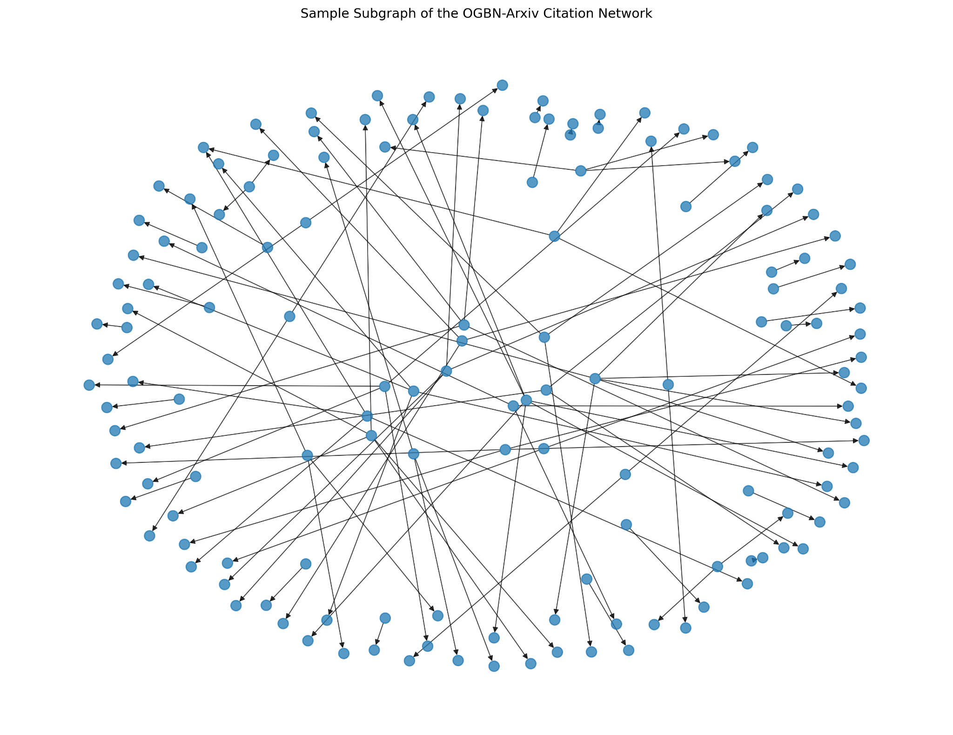
CCS4354 – TENSORS AND GRAPHS COURSEWORK
Graph Neural Network-Based Node Classification
on the OGBN-Arxiv Citation Network
GCN vs GraphSAGE • Explainability • Streamlit Graph Intelligence Dashboard
Presenters:
Dewmi Abeykoon | CIT-23-02-0090
Sithmi Umeshika | 23UG1-0078
Samoshi Rupasingha | 23UG1-0118
Gihan Chathuranga | 23UG1-0119
CCS4354 – Tensors and Graphs |
01
Notes:
Member 1: Start by greeting the panel and introduce the coursework title. Mention that the project uses OGBN-Arxiv, a citation network, and compares GCN with GraphSAGE. State that the presentation will cover the full pipeline from tensors to dashboard.

Slide 2
Presentation roadmap
01
Problem & objectives
02
Dataset & tensor workflow
Why graph learning is needed for citation networks
How OGBN-Arxiv is represented in tensors
03
Graph analysis & preparation
04
GCN and GraphSAGE
Edge list, sparsity, splits and normalization
Two GNN architectures for node classification
05
Training, tuning & evaluation
06
Explainability & dashboard
Adam, cross-entropy, early stopping and final metrics
PCA, neighborhood influence, ablation and Streamlit
CCS4354 – Tensors and Graphs |
02
Notes:
Member 1: Briefly explain the roadmap. Emphasize that the presentation is split equally across four members and that each part connects to the coursework tasks.

Slide 3
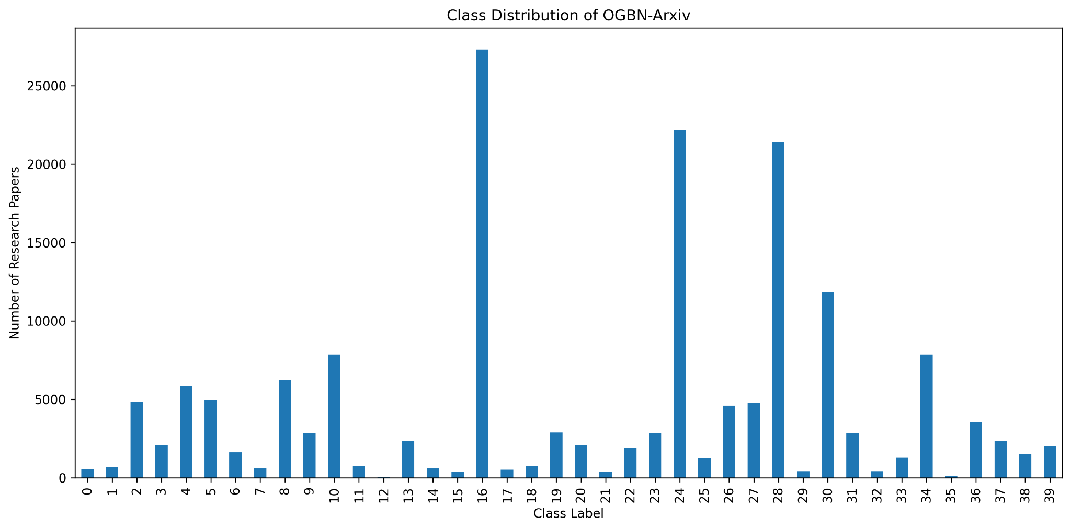
Dataset: OGBN-Arxiv citation network
Large-scale multi-class node classification
169,343
1,166,243
128
40
Research-paper nodes
Directed citation edges
Node feature dimensions
Research classes
Classification task
Each paper is a node. Citation links define graph structure. The target is to classify every paper into one of 40 research categories using both features and neighborhood information.
Why GNNs?
A traditional classifier uses only node features. A GNN also uses citation relationships, allowing connected papers to exchange information through message passing.
CCS4354 – Tensors and Graphs |
03
Notes:
Member 1: Explain the dataset scale: 169,343 nodes, more than 1.1 million edges, 128 features, and 40 classes. Point out the class imbalance visible in the chart and explain why this makes weighted and macro metrics important.

Slide 4
Tensor fundamentals used in the workflow
PyTorch tensors support the complete GNN pipeline
Tensor creation
Indexing
Node features and labels are represented as tensors
Training, validation and test nodes are selected by index tensors
Reshaping
Matrix multiplication
Labels and model outputs are aligned for loss calculation
Feature transformations use learned weight matrices
Aggregation
GPU device handling
Mean and standard deviation support feature normalization
Large-scale training benefits from CUDA acceleration
Example matrix multiplication
C = [[19, 22], [43, 50]]
These operations form the numerical base for graph preprocessing, GNN training and model evaluation.
CCS4354 – Tensors and Graphs |
04
Notes:
Member 1: Summarize that tensors are not separate from the main work; they are used throughout the pipeline for features, labels, indices, edge_index, logits and predictions.

Slide 5
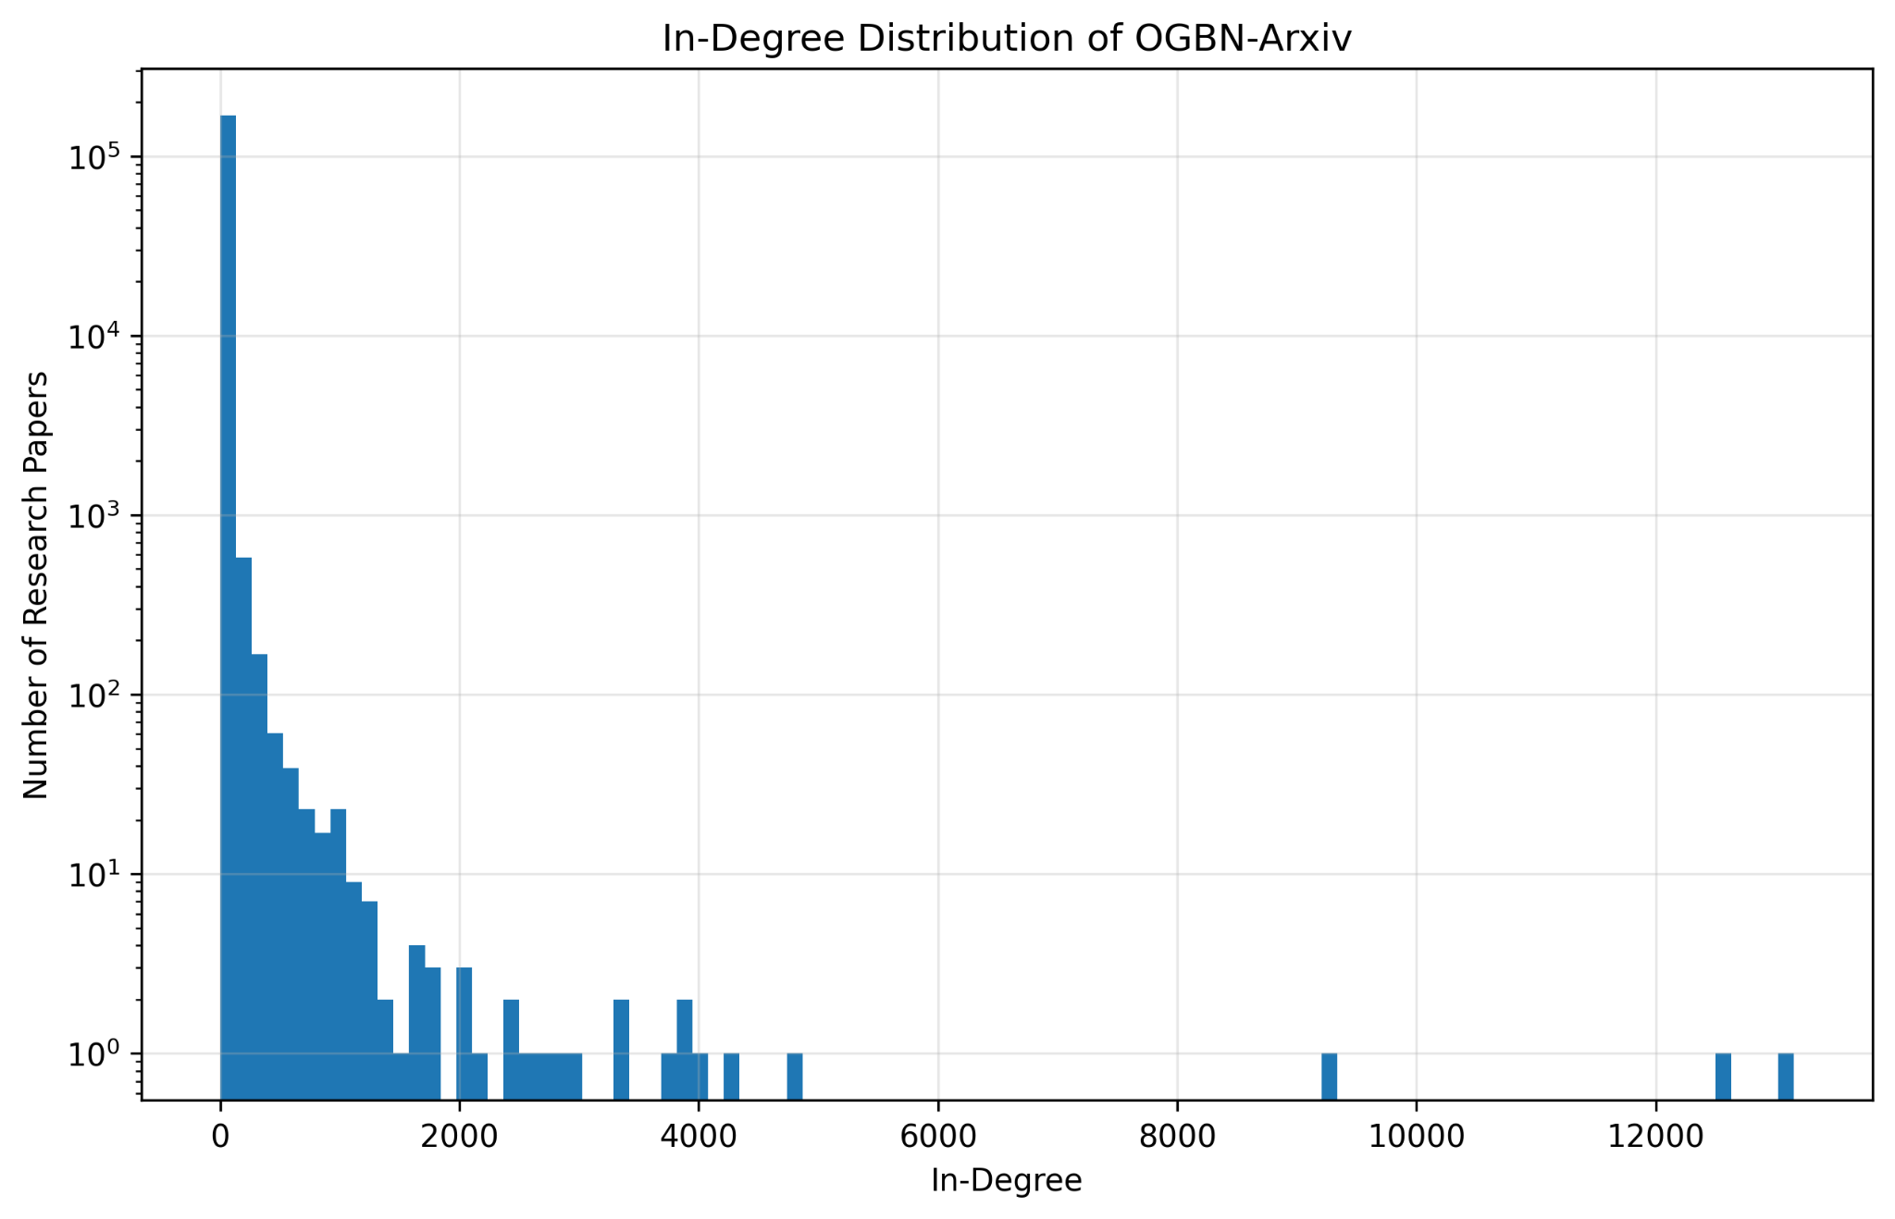
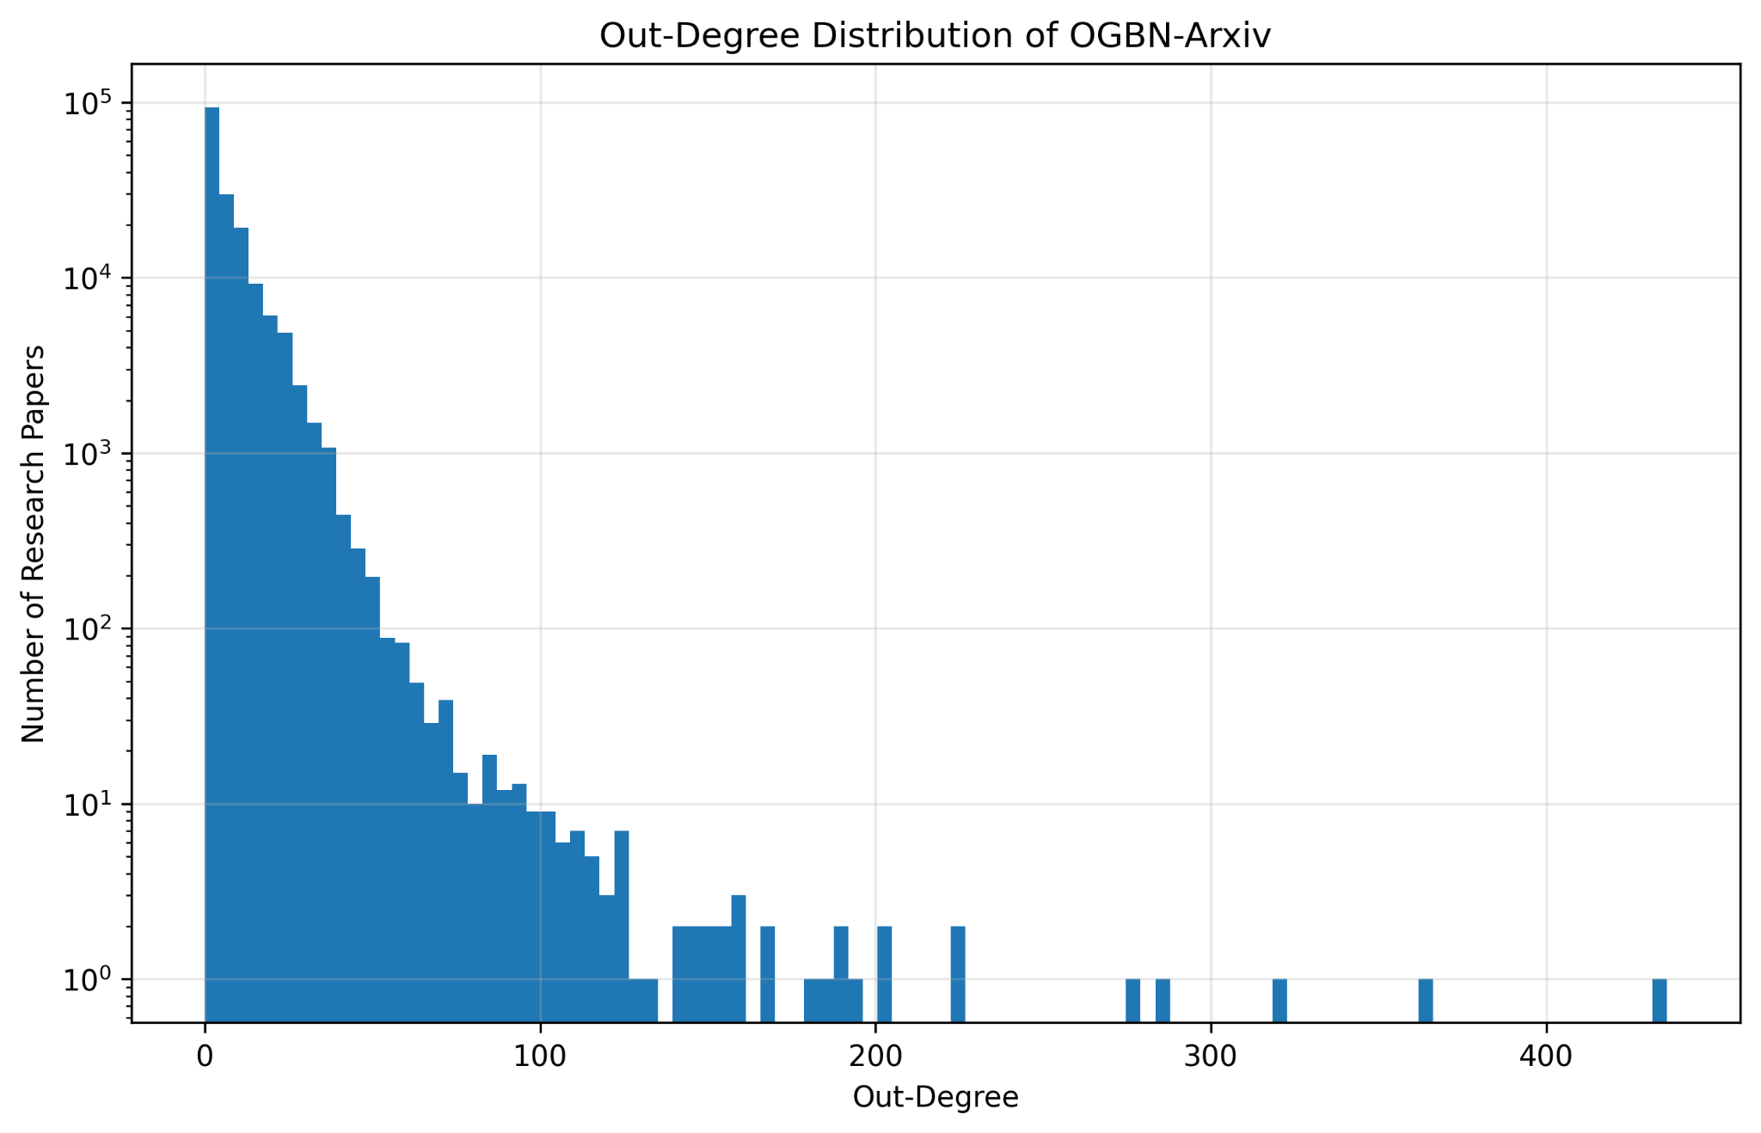
Graph representation and structural analysis
Citation network properties that influence GNN learning
Main finding
The graph is large, sparse and structurally non-uniform. Most nodes have few connections, while a few papers act as citation hubs.
0.0000407
1
141,223
13,155
Directed graph density
Weak components
Strong components
Max in-degree
CCS4354 – Tensors and Graphs |
05
Notes:
Member 2: Explain the edge-list representation and the sample subgraph. Point out the long-tailed in-degree and out-degree distributions, and mention that this affects how much neighborhood information different papers receive.

Slide 6
Graph data preparation
Leakage-aware preprocessing before model training
Load tensors
Validate data
Normalize features
Prepare edges
X: [169343, 128]
y: [169343]
No missing values
Valid labels and splits
Mean/std from training nodes only
2,315,598 message-passing edges
Official splits retained
Why this matters
Training: 90,941 nodes
Validation: 29,799 nodes
Test: 48,603 nodes
Total: 169,343 nodes
Feature normalization was calculated only from training nodes. This avoids validation/test leakage and makes the final evaluation more reliable.
CCS4354 – Tensors and Graphs |
06
Notes:
Member 2: Emphasize methodology. The official train, validation and test split was preserved, and normalization used only training statistics. Also mention that the directed graph was converted to a symmetric message-passing graph for GNN training.

Slide 7
Architecture 1: Graph Convolutional Network
GCN baseline and tuned model for citation-neighborhood learning
128 input
features
GCNConv
128 hidden
BatchNorm
ReLU
Dropout
GCNConv
40 logits
Class
prediction
GCN strengths
Selected tuned setting
Parameter-efficient graph convolution combines paper features with information from connected citation nodes.
Hidden dimension: 128
Graph layers: 3
Dropout: 0.5
Learning rate: 0.005
21,928
0.7212
0.7114
Baseline parameters
Best validation accuracy
Test accuracy
CCS4354 – Tensors and Graphs |
07
Notes:
Member 2: Explain the GCN flow from input features to logits. Mention BatchNorm, ReLU and Dropout. State that the tuned GCN used 3 layers and reached 0.7212 validation accuracy.

Slide 8
Architecture 2: GraphSAGE
Mean-based neighborhood aggregation for paper-node representation
128 input
features
SAGEConv
mean aggregation
BatchNorm
ReLU
Dropout
SAGEConv
40 logits
Class
prediction
GraphSAGE idea
Selected tuned setting
The target node representation is combined with the mean representation of its neighbors. This provides a flexible way to learn from citation neighborhoods.
Hidden dimension: 128
Graph layers: 3
Dropout: 0.5
Learning rate: 0.005
43,432
0.7256
0.7117
Baseline parameters
Best validation accuracy
Test accuracy
CCS4354 – Tensors and Graphs |
08
Notes:
Member 2: Explain that GraphSAGE uses mean aggregation and has more trainable parameters than GCN. State that it reached the strongest validation result during tuning.

Slide 9
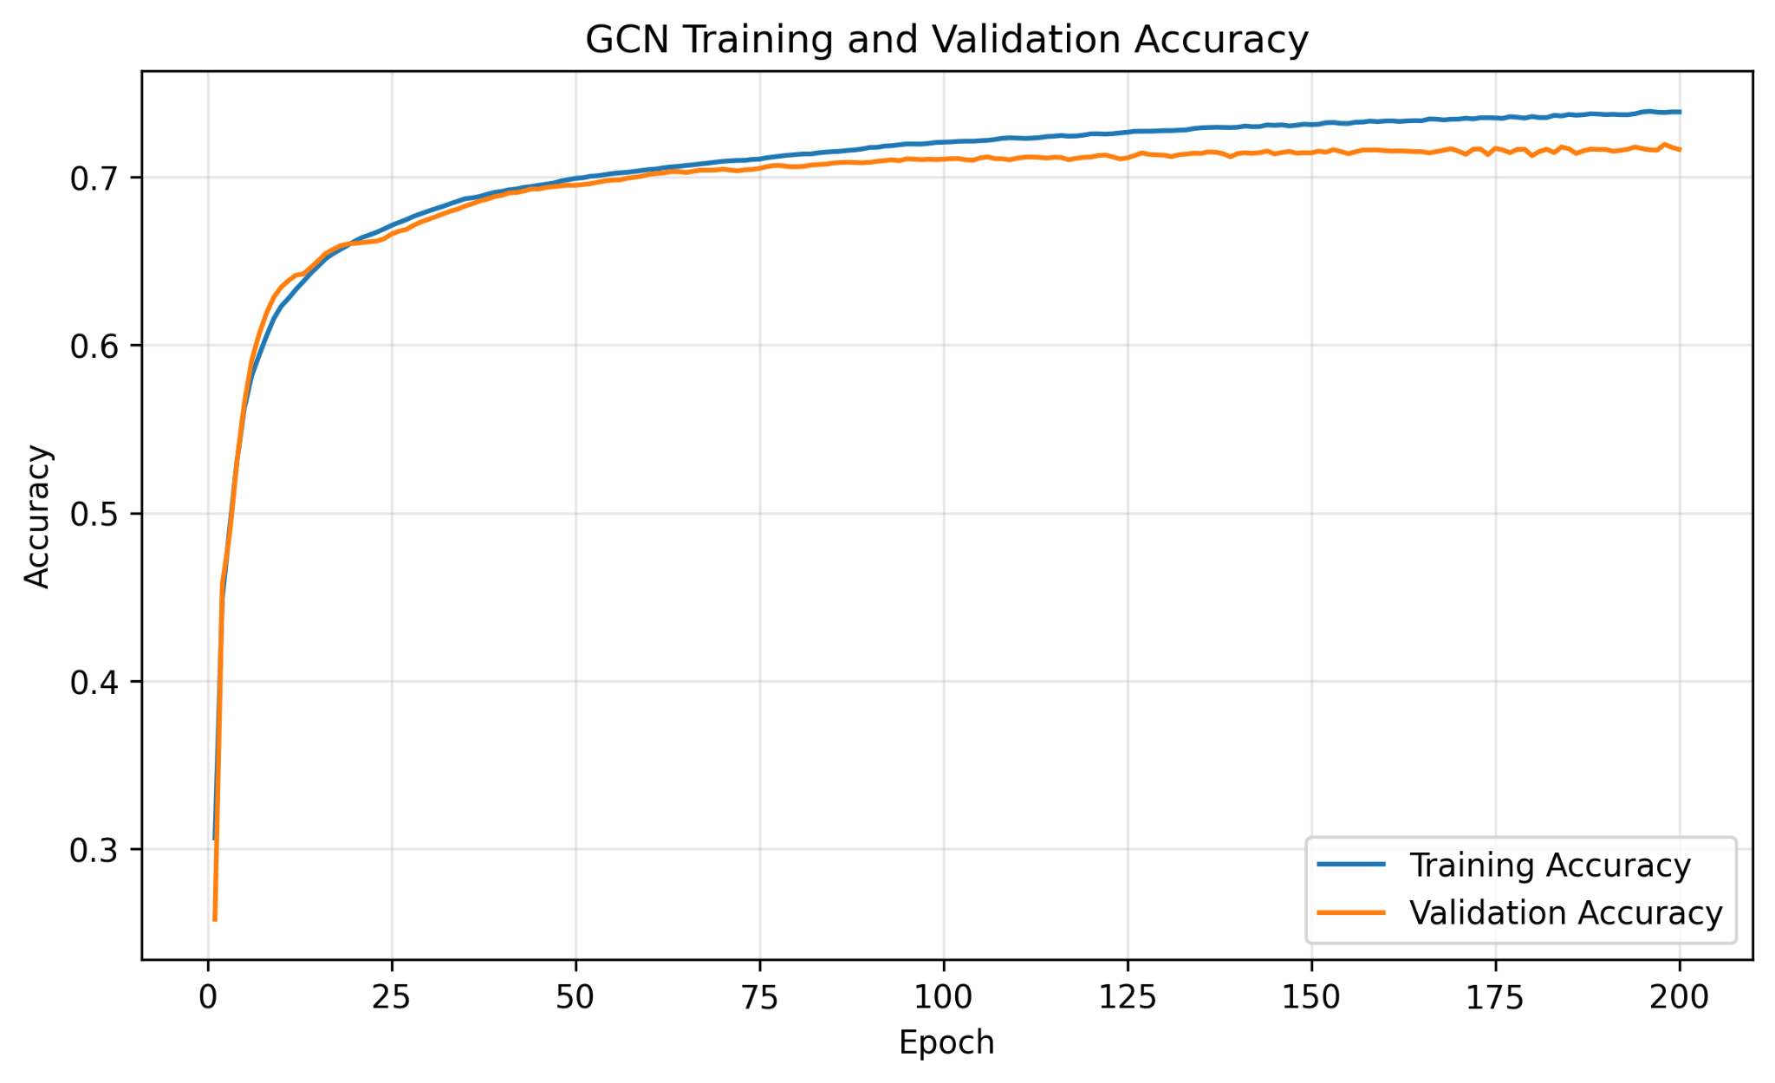
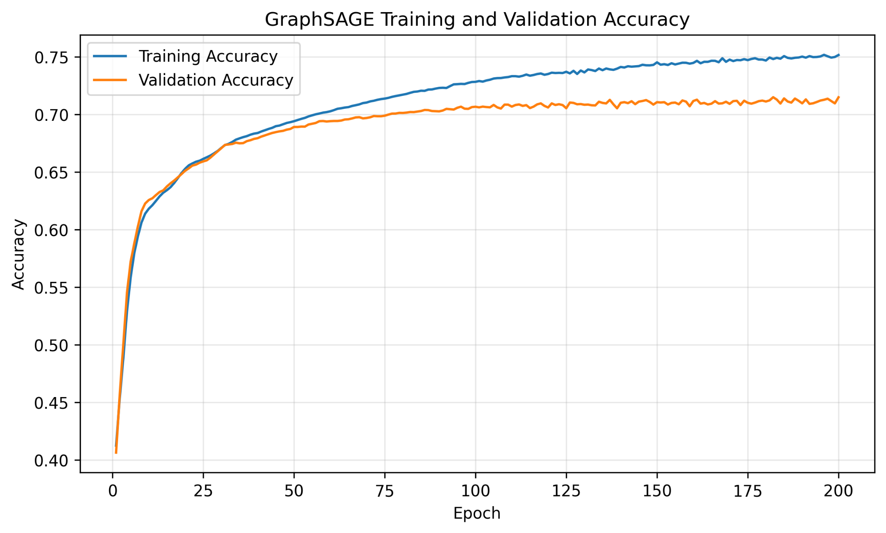
Training strategy
CrossEntropyLoss, Adam optimizer and early stopping
Training loop
Optimization controls
No test leakage
1. Forward pass over full graph
2. Loss on training nodes only
3. Backpropagation
4. Adam optimizer update
5. Validation monitoring
Loss: CrossEntropyLoss
Optimizer: Adam
Weight decay: 0.0005
Max epochs: 200
Early stopping patience: 30
The test set was not used for hyperparameter selection. It was reserved for final model evaluation.
CCS4354 – Tensors and Graphs |
09
Notes:
Member 3: Explain how the models were trained. Highlight that loss was calculated only on training nodes and validation accuracy was used for checkpointing and model selection.

Slide 10
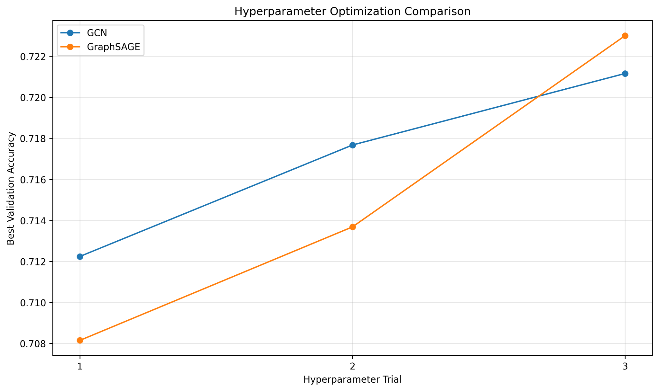
Hyperparameter optimization
Model capacity, depth, dropout and learning rate were compared
Trial
Hidden
Layers
Dropout
LR
1
64
2
0.3
0.010
2
128
2
0.5
0.010
3
128
3
0.5
0.005
Best tested configuration
Both models performed best with 128 hidden dimensions, 3 graph layers, 0.5 dropout and learning rate 0.005.
0.7212
0.7256
GCN best validation
GraphSAGE best validation
CCS4354 – Tensors and Graphs |
10
Notes:
Member 3: Talk through the three tested configurations. Explain that deeper 3-layer models with a lower learning rate performed best. GraphSAGE achieved the highest validation accuracy during tuning.

Slide 11
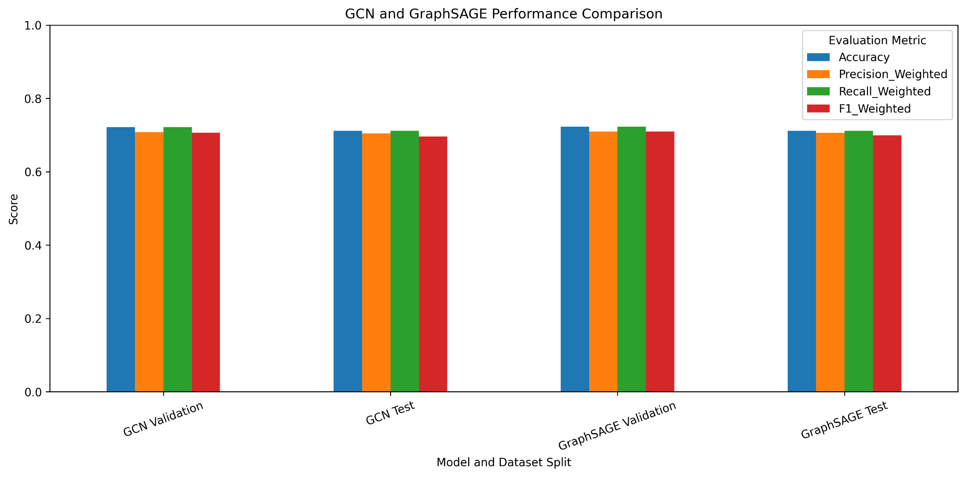
Final model evaluation
Accuracy, precision, recall and F1 on validation and test nodes
Model/Split
Accuracy
F1 weighted
F1 macro
GCN Val
0.7212
0.7063
0.5026
GCN Test
0.7114
0.6966
0.4890
SAGE Val
0.7256
0.7096
0.5030
SAGE Test
0.7117
0.6994
0.4854
Key interpretation
GraphSAGE achieved slightly higher test accuracy and weighted F1. GCN achieved slightly higher macro F1 and a smaller generalization gap.
0.0098
0.0113
GCN gap
GraphSAGE gap
CCS4354 – Tensors and Graphs |
11
Notes:
Member 3: Explain that the final conclusion should not be based on accuracy only. Weighted metrics show overall performance; macro metrics show class-balanced performance. Mention the small generalization gaps.

Slide 12
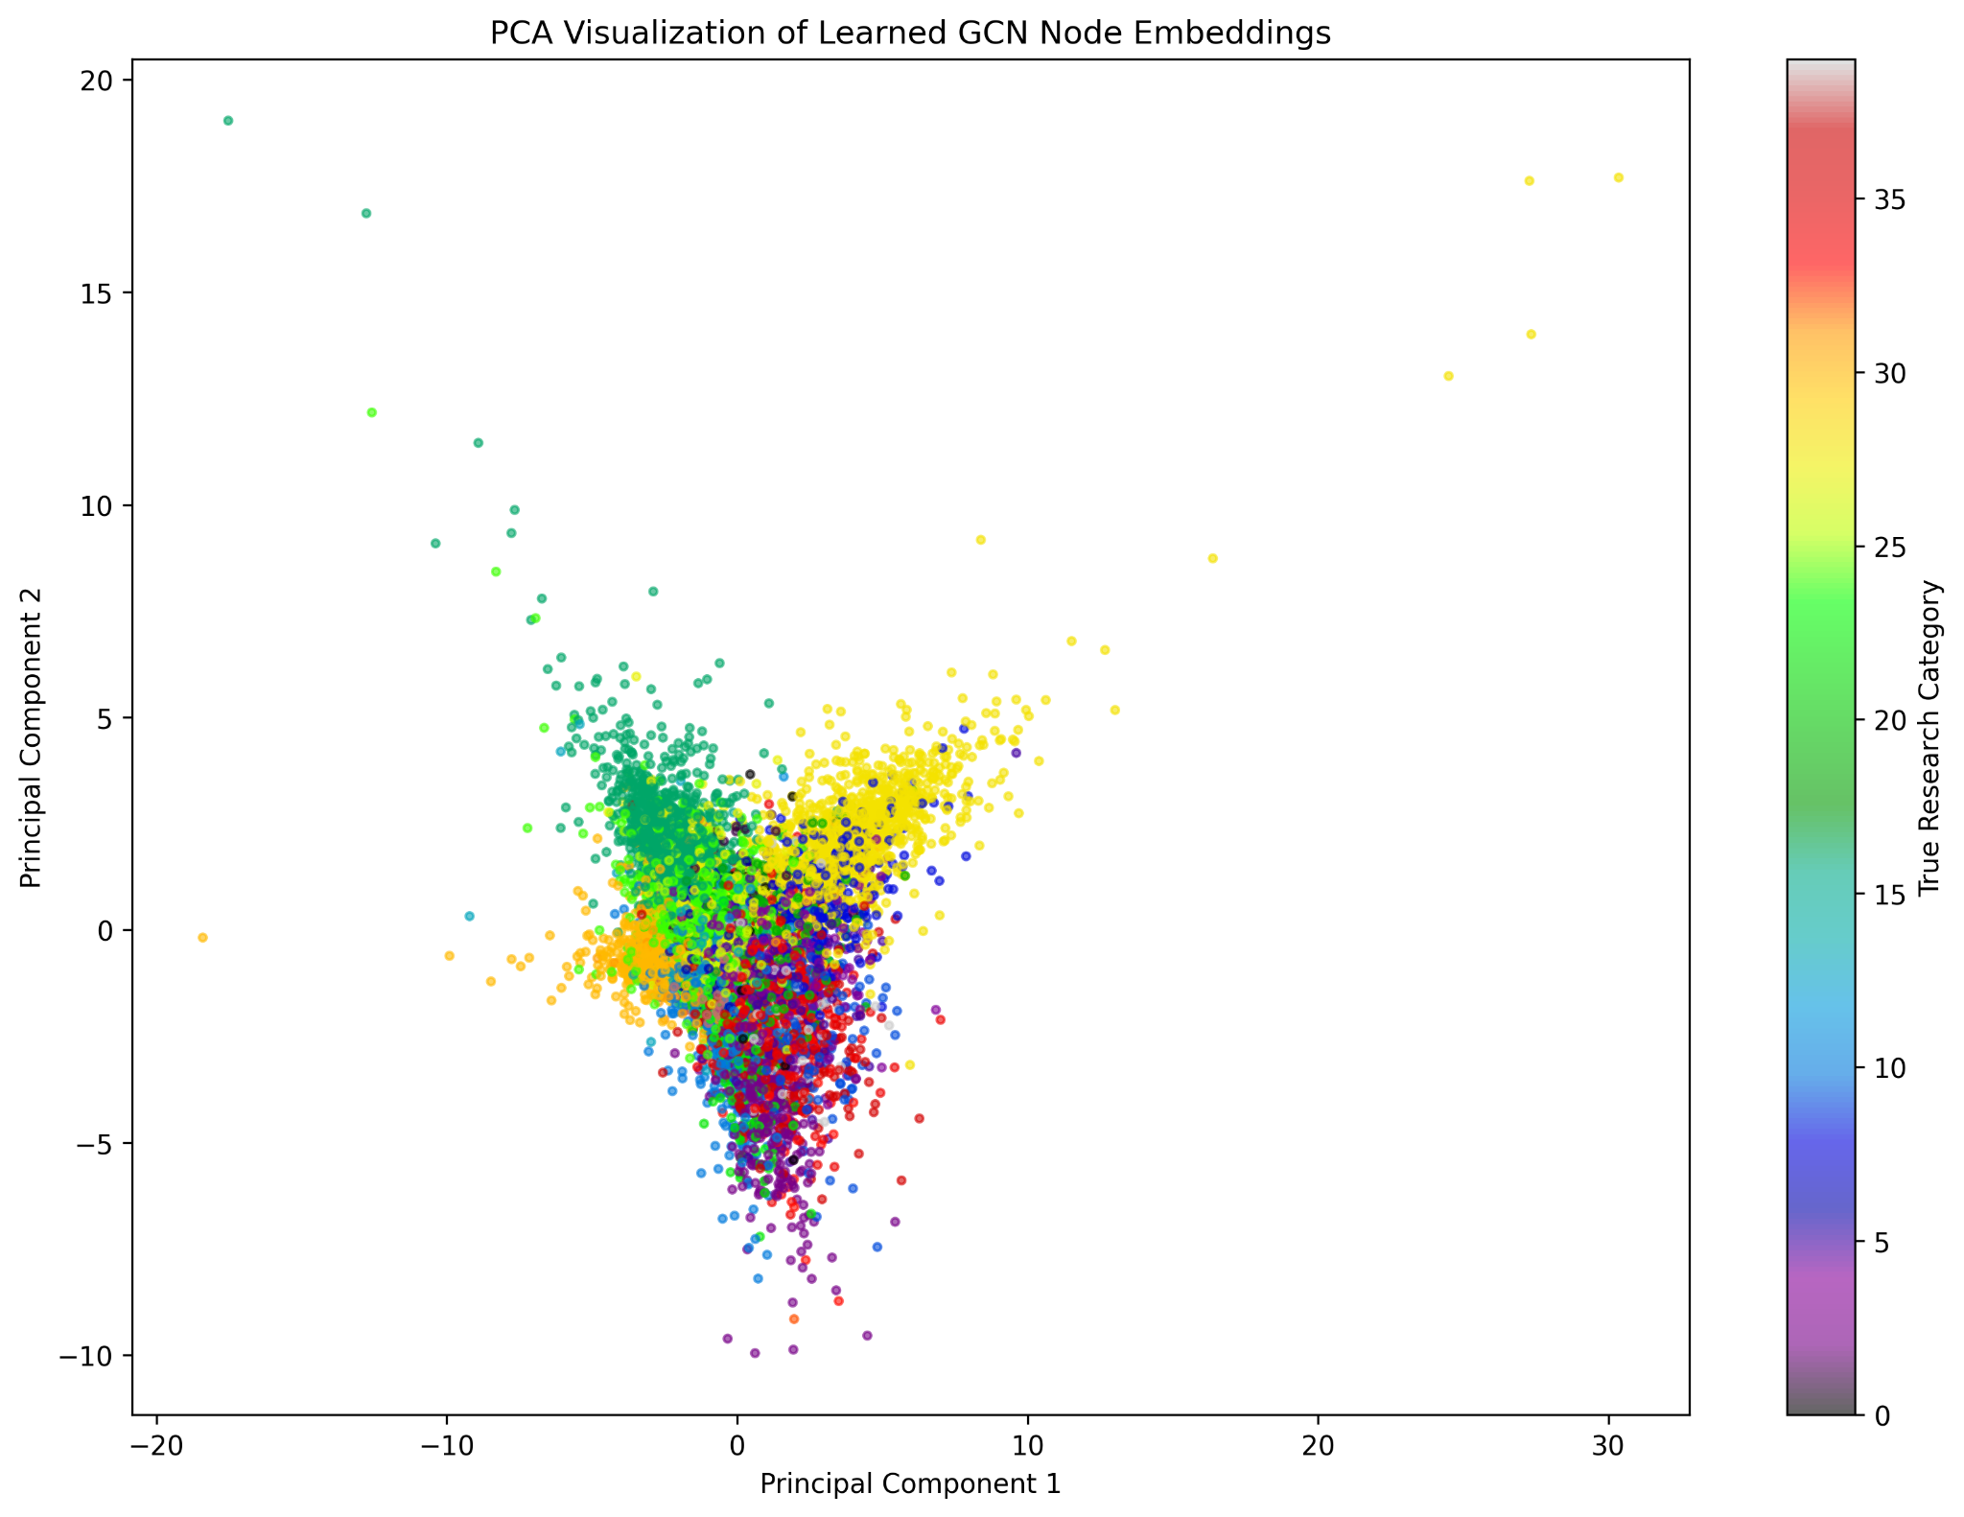
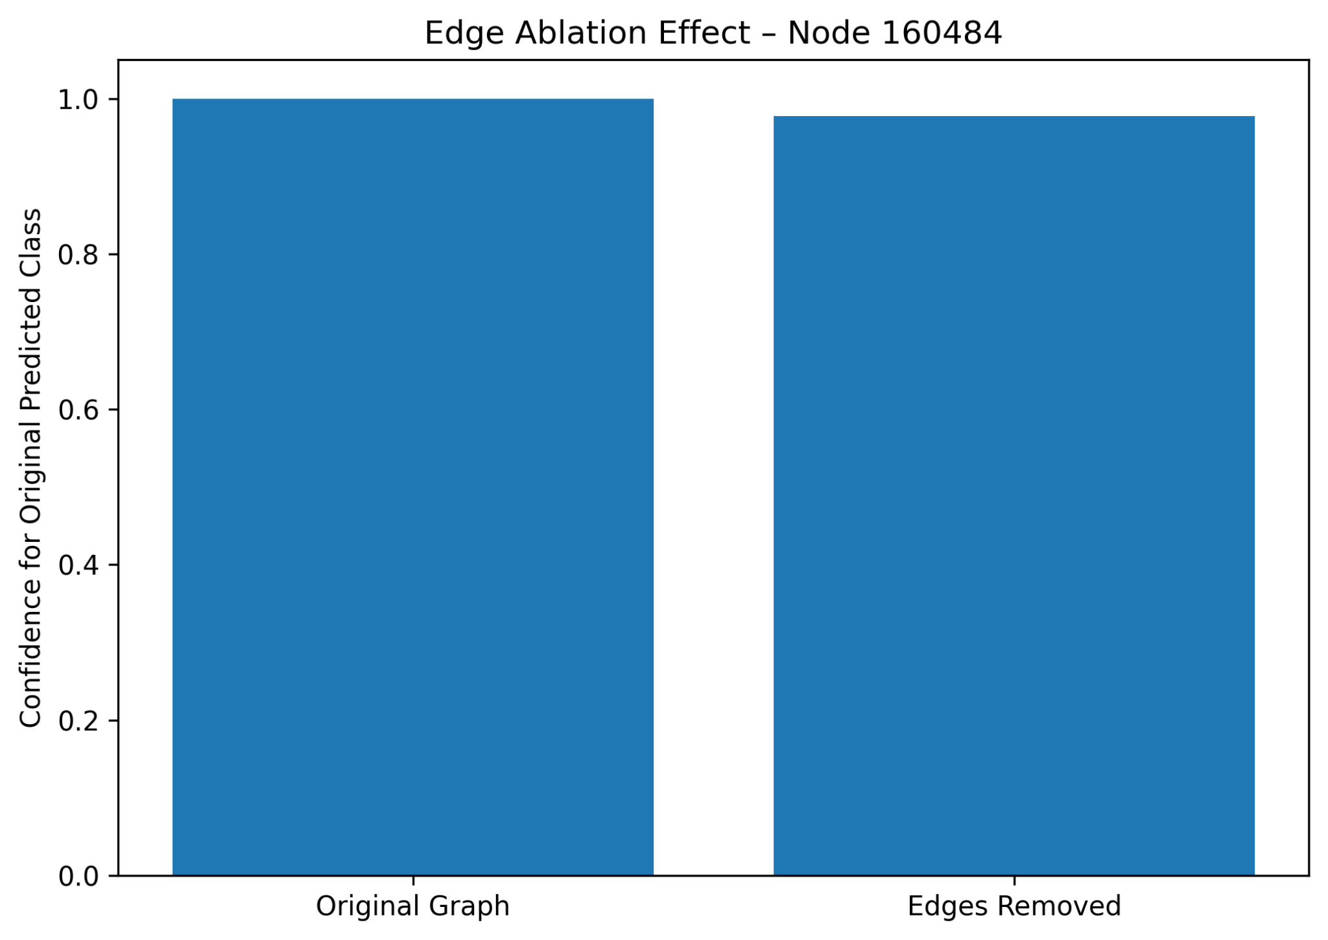
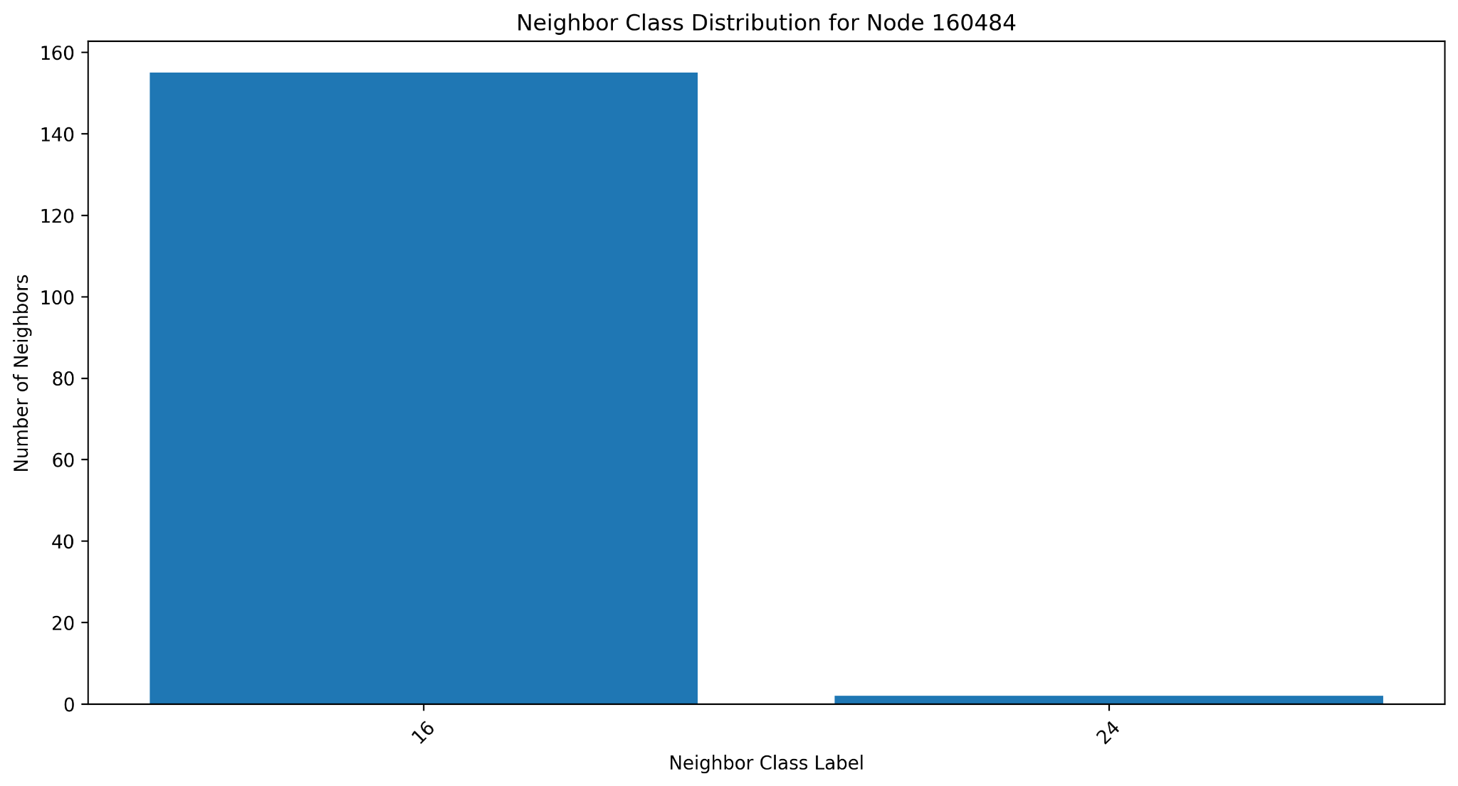
Explainability: what influenced predictions?
PCA embeddings, neighborhood influence and edge ablation
Selected node insight
Edge ablation result
Node 160484 was correctly classified as class 16. 155 out of 157 neighbors matched the predicted class, giving a same-class ratio of 0.9873.
After removing neighborhood edges, the prediction remained class 16, but confidence reduced from 1.0000 to 0.9773. This shows both node features and graph context support the prediction.
CCS4354 – Tensors and Graphs |
12
Notes:
Member 3: Explain each explainability method. PCA gives a global view, neighborhood influence gives a local explanation, and edge ablation tests whether graph connections affect the confidence.

Slide 13
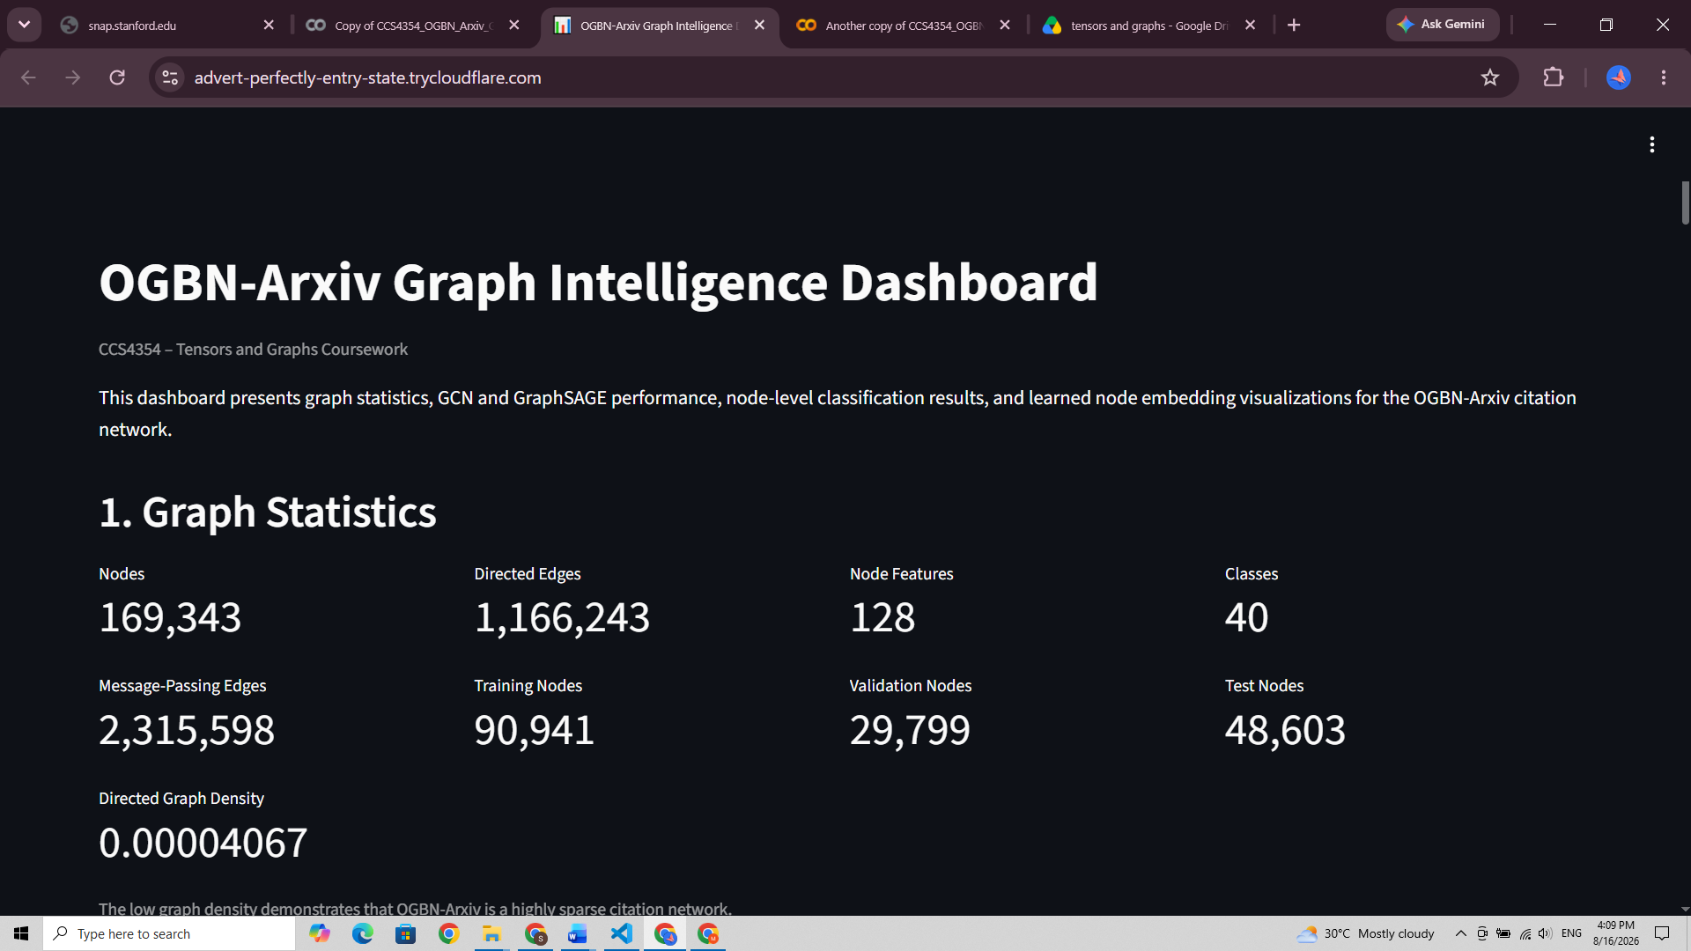
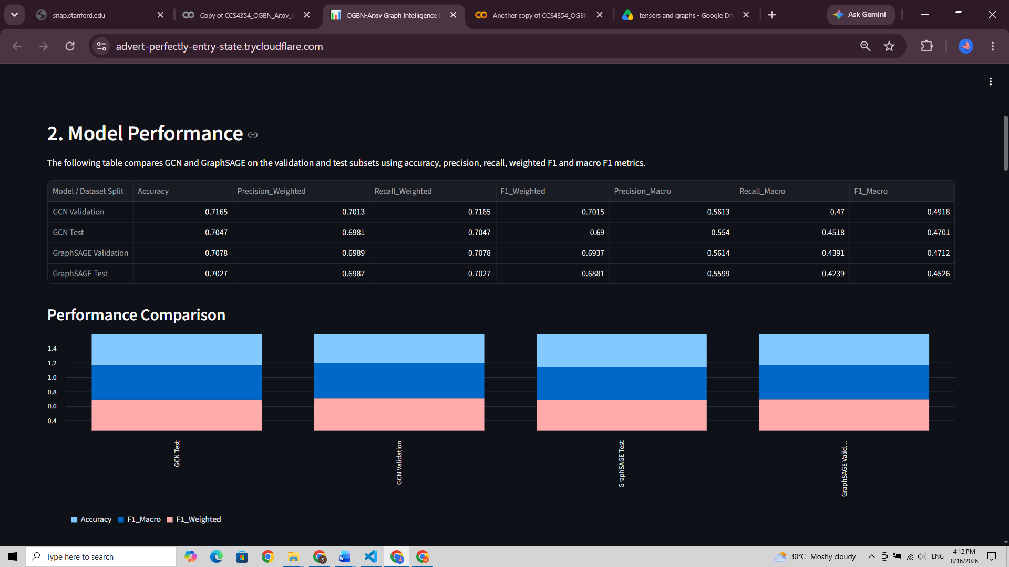
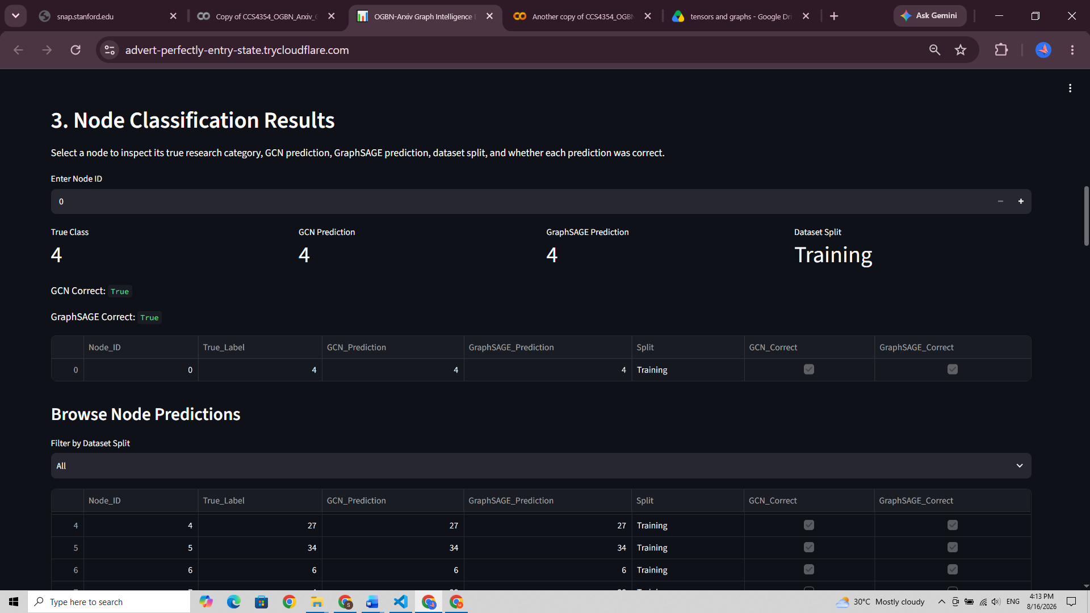
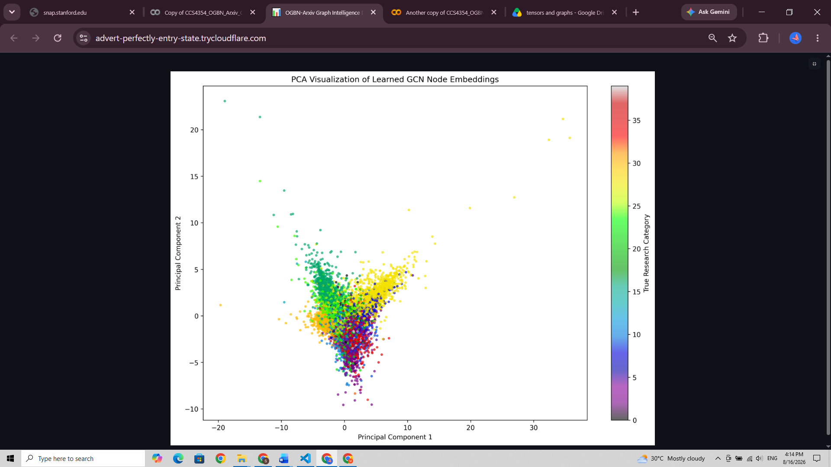
Streamlit Graph Intelligence Dashboard
Interactive presentation of graph statistics, model results and embeddings
Dashboard design
The app loads exported JSON, CSV and image files rather than retraining models. This makes it lightweight and suitable for demonstration.
CCS4354 – Tensors and Graphs |
13
Notes:
Member 4: Show the dashboard components. Mention graph statistics, model performance, node classification results, PCA visualization and sample subgraph. Emphasize that the dashboard does not require retraining.

Slide 14
Key findings
What the experiments showed
01
Graph structure matters
02
Class imbalance affects evaluation
Citation edges provide useful neighborhood context beyond text-derived node features.
Macro F1 is lower than weighted F1, showing minority classes are harder to classify.
03
Tuning improves both GNNs
04
GraphSAGE slightly leads overall
A 3-layer, 128-hidden configuration with LR 0.005 produced the best tested performance.
GraphSAGE had slightly higher test accuracy and weighted F1.
05
GCN is more class-balanced
06
Explainability strengthens insight
GCN achieved slightly higher macro F1 and a smaller generalization gap.
PCA, neighborhood analysis and edge ablation show how graph context influences predictions.
CCS4354 – Tensors and Graphs |
14
Notes:
Member 4: Summarize the main findings clearly. Avoid reading all text. Emphasize the comparison between GraphSAGE and GCN and the importance of macro metrics.

Slide 15
Limitations and future improvements
Critical reflection for viva discussion
Limitations
Future improvements
Strong class imbalance reduces macro-level performance.
Mean aggregation treats all neighbors uniformly.
Hyperparameter search was meaningful but not exhaustive.
Full-graph training is computationally expensive.
Graph Attention Networks to learn neighbor importance.
Class-weighted loss for minority classes.
Neighbor sampling for scalability.
Additional explainability using t-SNE, UMAP or GNNExplainer.
CCS4354 – Tensors and Graphs |
15
Notes:
Member 4: Present this as critical reflection. Explain that limitations are normal in large graph-learning tasks and that future improvements are realistic research directions.

Slide 16
Thank You
Questions & Answers
CCS4354 – Tensors and Graphs |
16
Notes:
All members: Be ready for Q&A. Possible questions include why GCN and GraphSAGE were selected, why CrossEntropyLoss was used, how leakage was prevented, why macro F1 is lower, and how the dashboard works.

